Slide 1

Moose Tornadoes
by Carre Perkins and Jules Real
Notes:
Jules

Slide 2

Why “Moose Tornadoes”?
It was the least offensive random name generated through a random name generator.
Notes:
Jules

Slide 3

Machine Learning Project
There is a universal desire among all humans to live a life of happiness. For decades, the average American employee worked a 9-to-5 until they were able to retire, hopefully in the lap of luxury.
However, the financial markets are volatile and employment with guaranteed pensions have become scarce.
Notes:
Carré

Slide 4
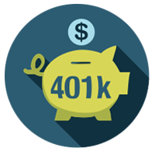
Machine Learning Project
After the financial collapse in the early 2000’s and the rise of 401k mismanagement lawsuits, it is imperative now more than ever that the American worker is less dependent on others for the management of their retirement and more engaged in their stock market investments for maximum positive results.
Notes:
Carré
Reference: https://www.marketwatch.com/story/401k-lawsuits-are-surging-heres-what-it-means-for-you-2018-05-09

Slide 5
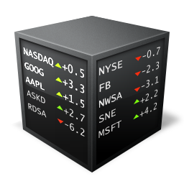
Machine Learning Project
The goal for this project is to utilize what we have learned about machine learning to accurately predict the stock market.
Financial markets generally have short feedback cycles. Therefore, you can quickly validate your predictions on new data.
Notes:
Jules

Slide 6

Machine Learning Project
The primary goal is to create an accurate model.
The secondary goal is to include analyzation of which economic factors are the best indicators and what adjustments are needed to the model to create better predictions.
Notes:
Jules

Slide 7
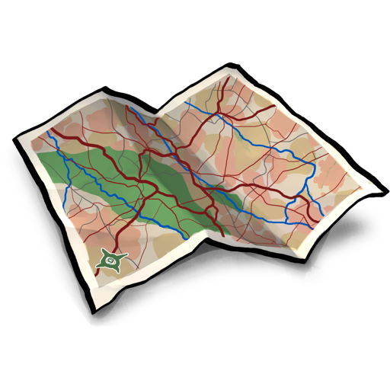
Finding The Data
We referenced:
Yahoo Finance
Quandl
Tutoring expertise
TA pointers
YouTube programmers
Previous coursework
Notes:
Jules

Slide 8

Additional Technology Used
We also utilized:
SciKit Learn
Python Pandas
Tableau
Heroku
Flask
Numpy
Matplotlib
And more!
Notes:
Jules

Slide 9
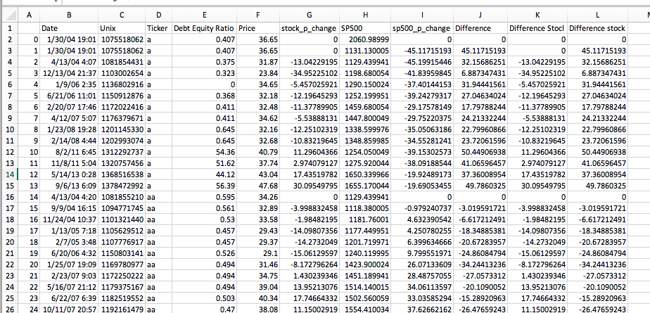
Cleaning The Data
We spent most of our time finding and cleaning stock data. Our stock information came from Yahoo Finance and our S&P data from Quandl. When we ran Moose.py, combined data was saved as a CSV file.
Notes:
Carré
We tried to keep as much data as we could, but ultimately if too many errors were generated the data was not included. Running the code to create our csv file took around 30 minutes each time we ran. We did not adjust for weekend/holiday date variations

Slide 10
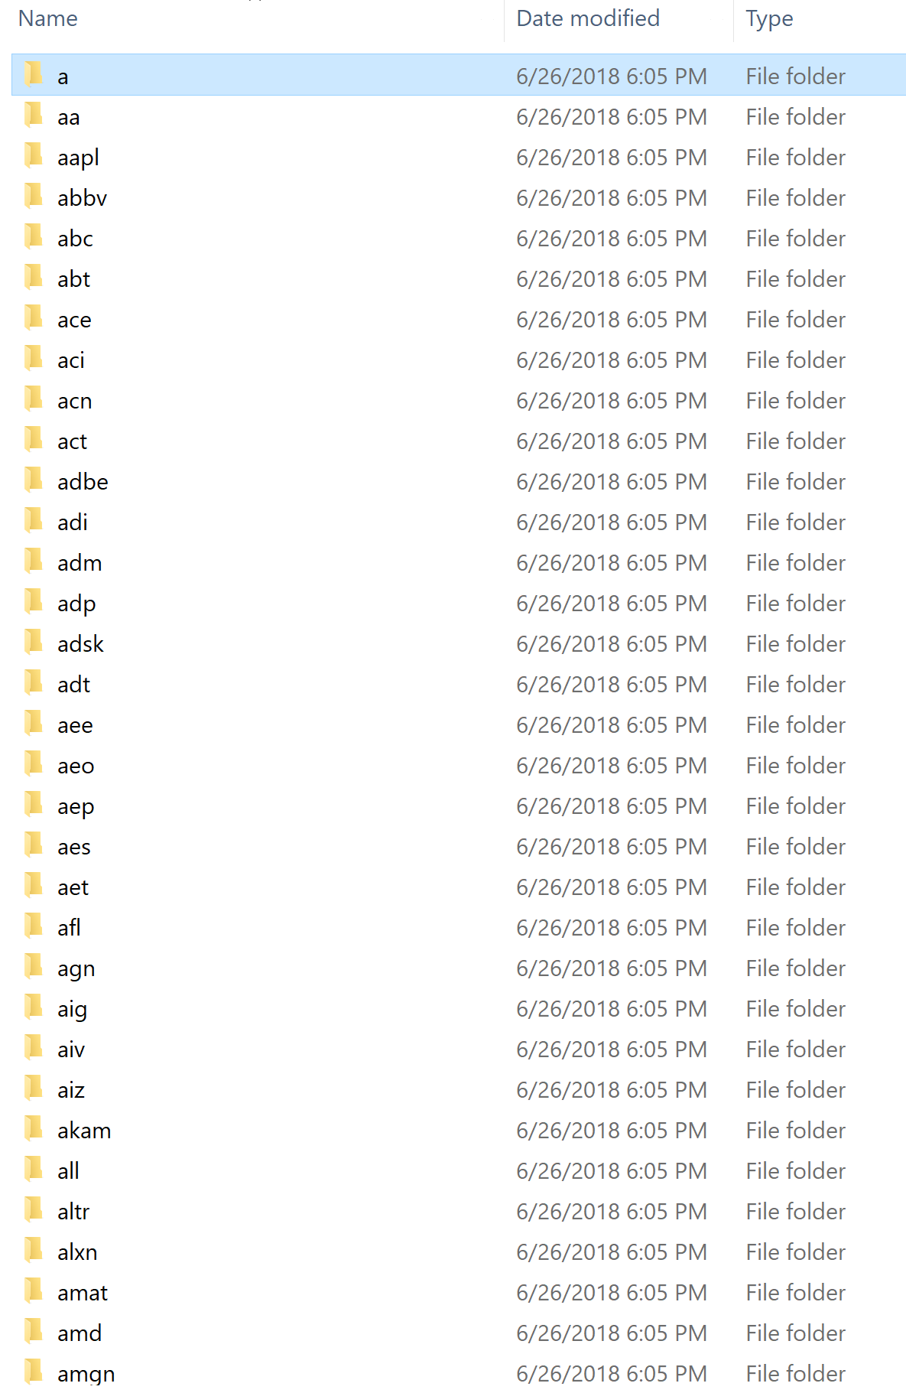
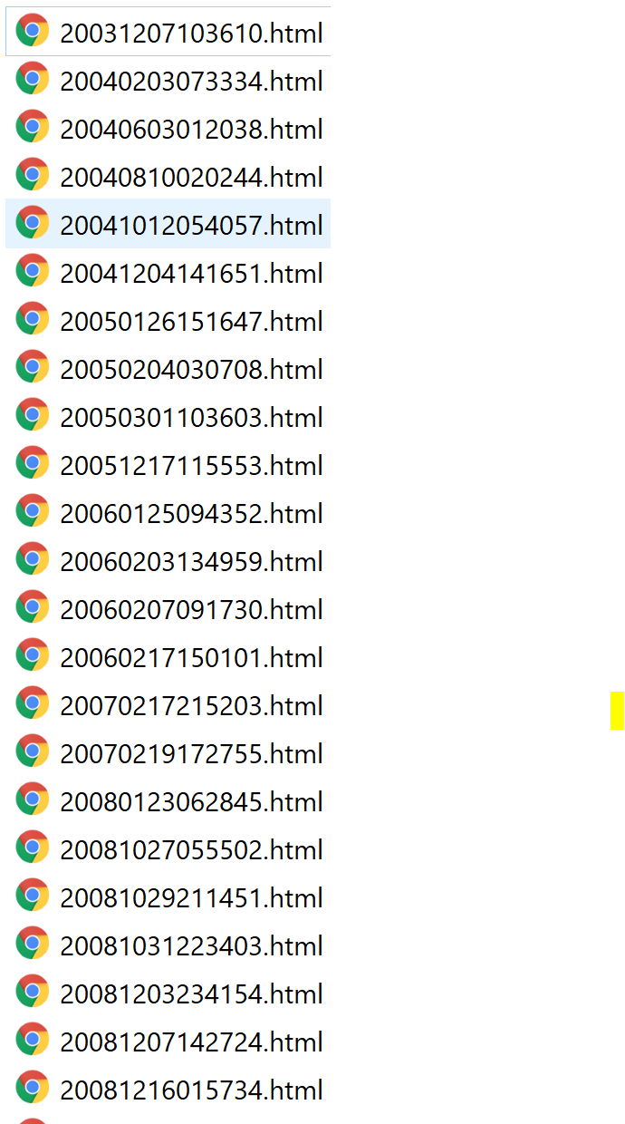
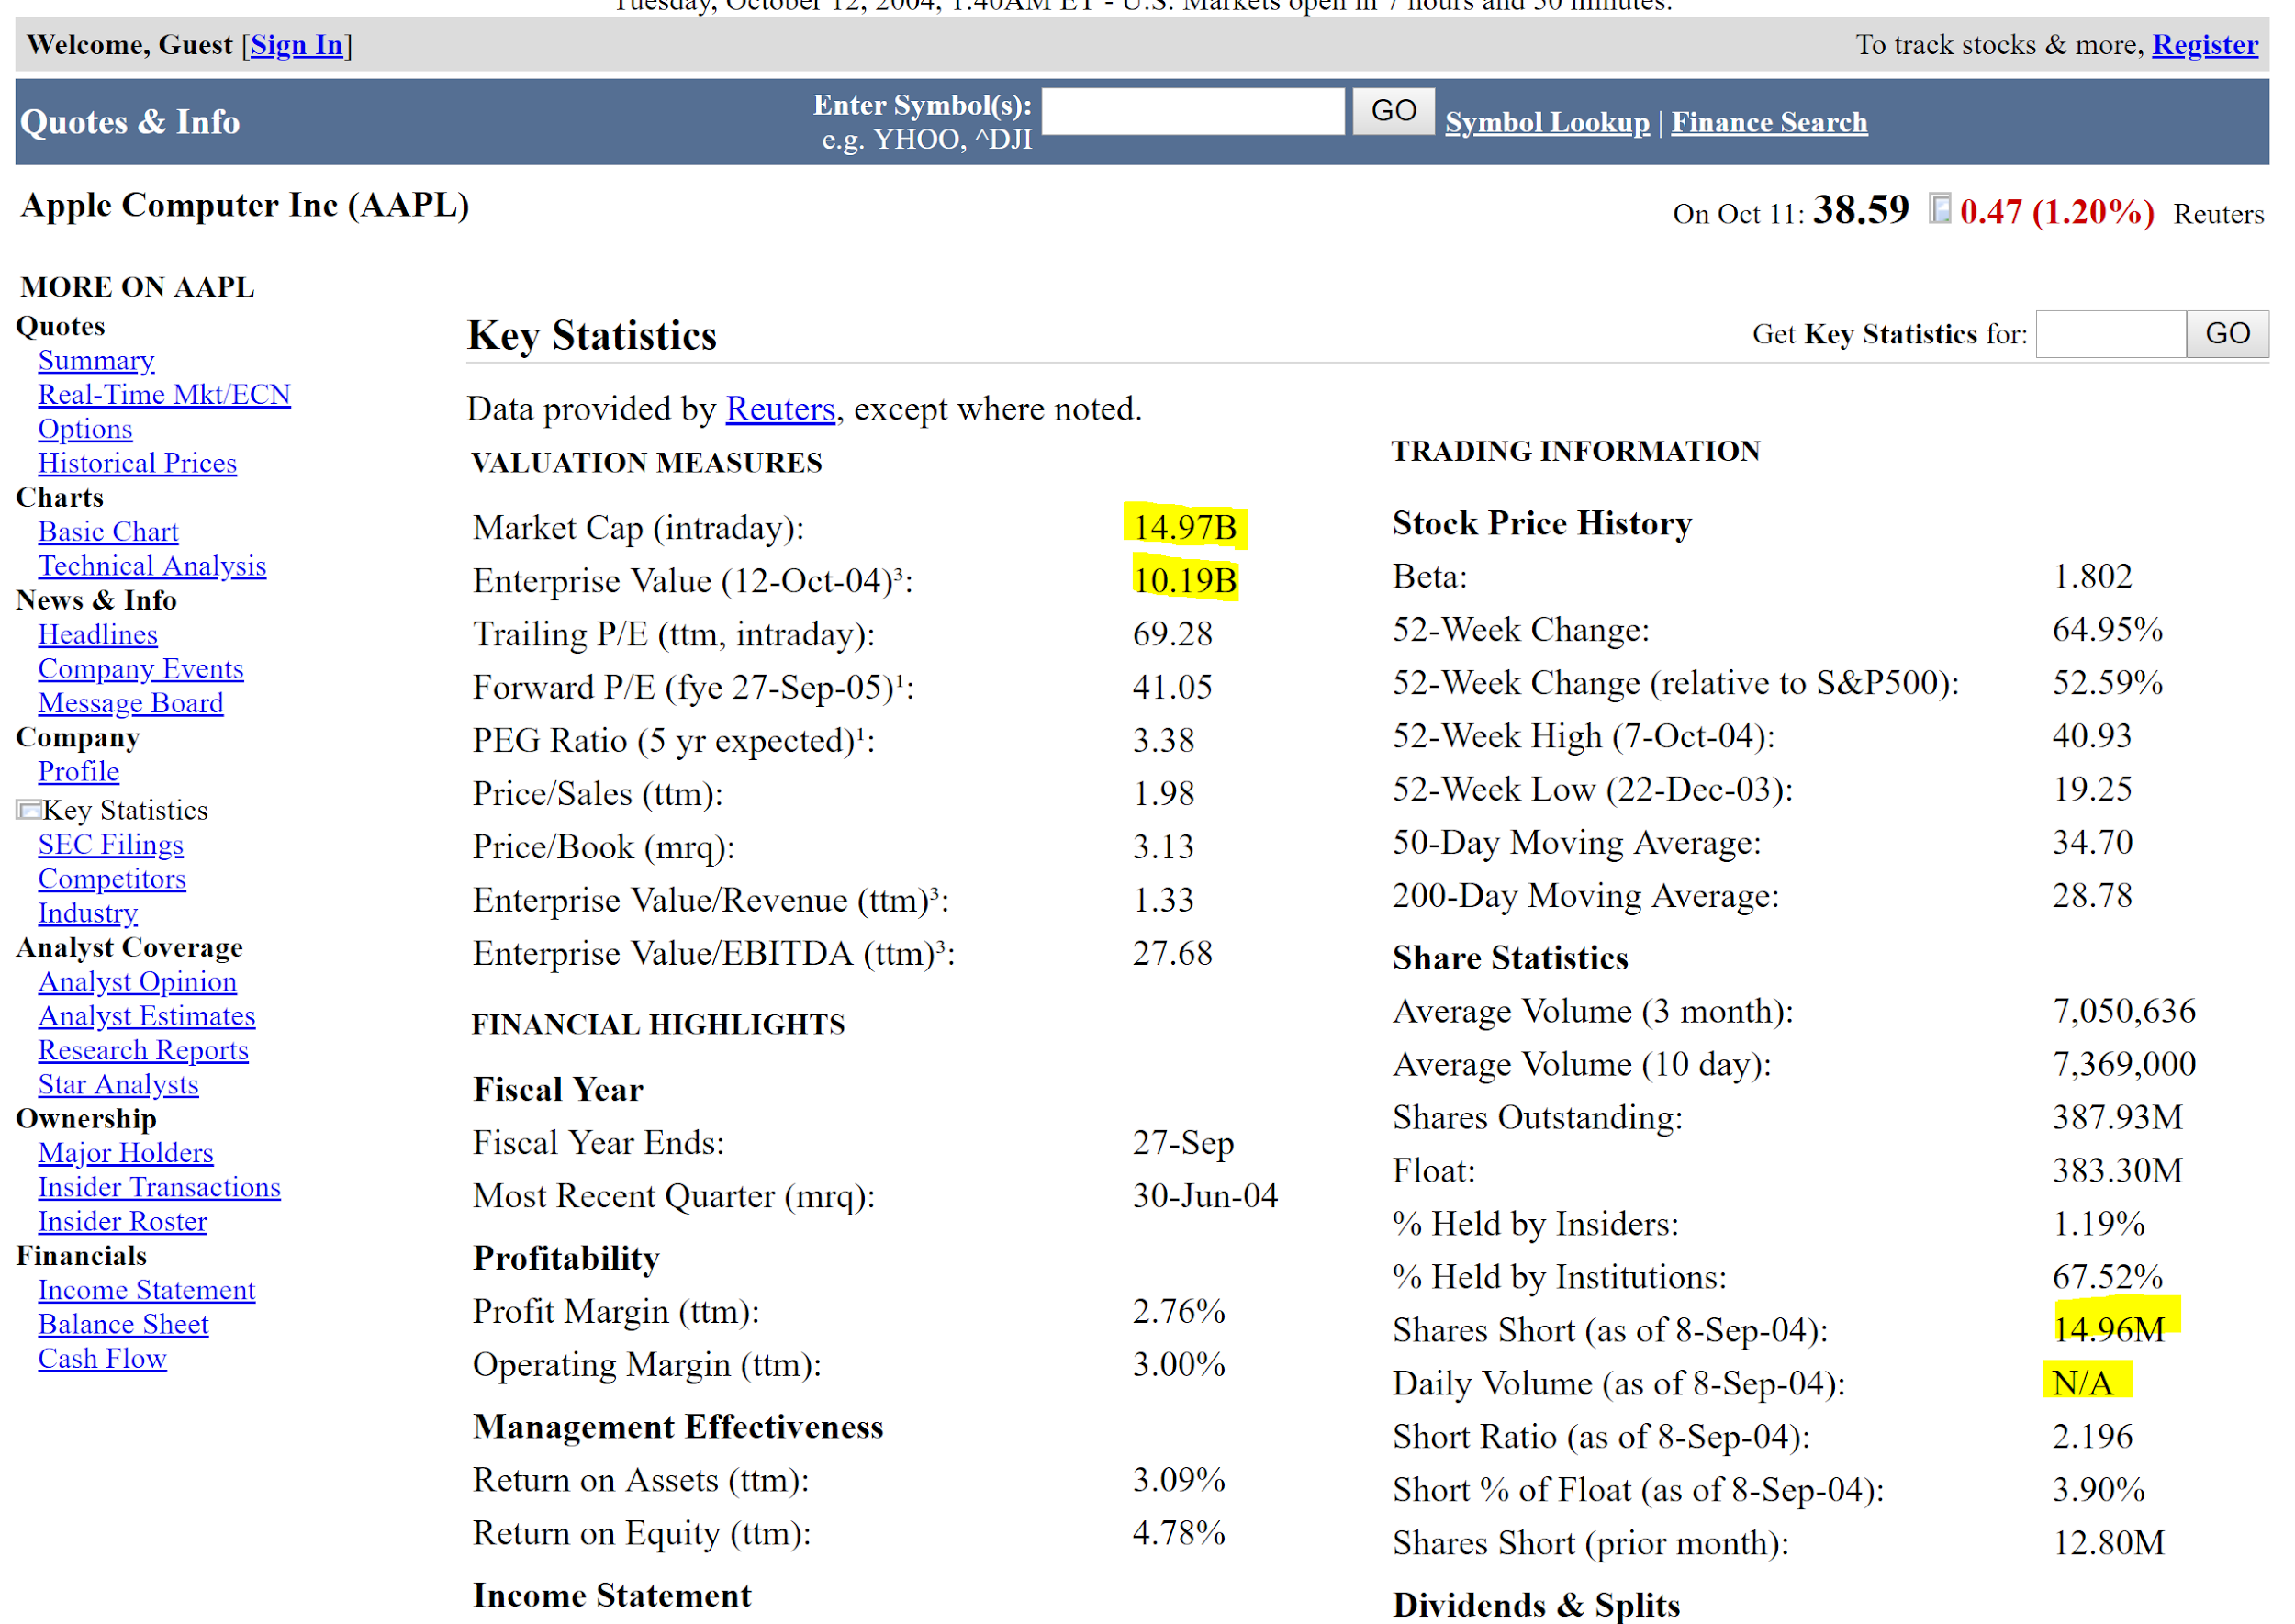
Cleaning The Data
Notes:
Carré
We had 560 folders for various tickers. In each folder was an html page from yahoo finance. From yahoo finance we pulled 35 features to analyze for prediction analysis.
Highlighted in yellow are some of the examples of data cleaning.
We chose to collect data in this format instead of with APIs because 1) Quandl premium subscription required, 2) we didn’t want to overload Yahoo Finance or SEC with data requests.

Slide 11
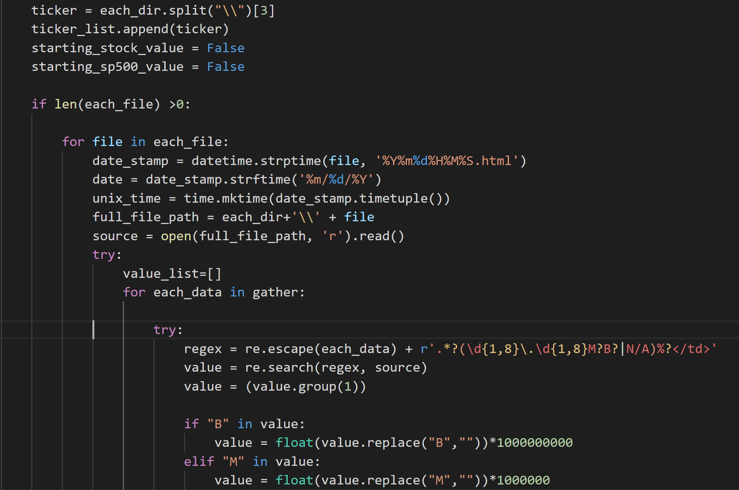
Cleaning The Data
Initial roadblocks included gathering, cleaning and combining the data between Yahoo Finance and Quandl.
Notes:
Carré
Date matching and cleaning “B”, “M”

Slide 12
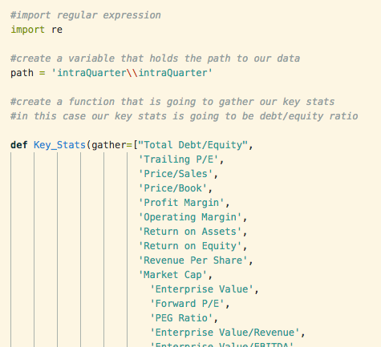
How We Did It
We began by creating a variable that would hold the path to our data, then creating a function to gather key stats. We then created a pandas dataframe to hold this.
Notes:
Jules

Slide 13
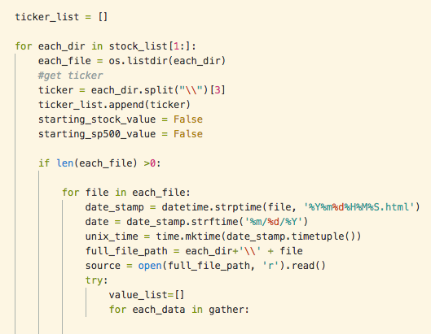
How We Did It
We then looped through the stocks, gathering information and storing it. Afterwards, we appended it into a dataframe and then to a new CSV file, which was used to create graphs in Tableau.
Notes:
Jules

Slide 14
Machine Learning - Model, Fit, Predict
Model: SVC from SVM
35 features
Scaled our data so all “y”s were between 0-1
Notes:
Carré

Slide 15
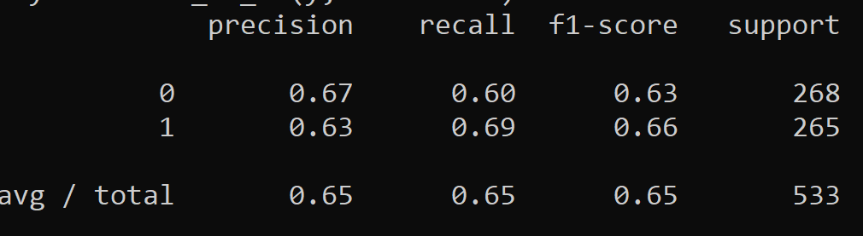
Machine Learning - Model, Fit, Predict
Classification Report:
Notes:
Carré
The F1 score is a weighted harmonic mean of precision and recall such that the best score is 1.0 and the worst is 0.0.

Slide 16
Machine Learning - Model, Fit, Predict
Predict? We need to do some feature engineering along with additional model training to improve our score. We turned to Tableau to help identify trends and key features we could focus on.
Notes:
Carré
The F1 score is a weighted harmonic mean of precision and recall such that the best score is 1.0 and the worst is 0.0.

Slide 17
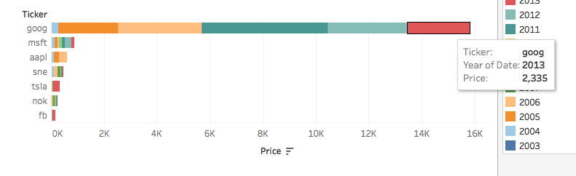
Utilizing The Data
The data was then uploaded to Tableau and used to create graphs. We used these graph to analyze which features we should focus on to fine tune machine learning.
Notes:
Jules

Slide 18
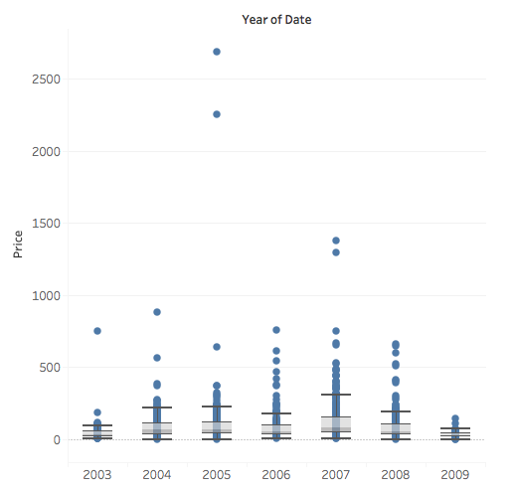
Analyzing the Training Data
The vast majority of stock prices over the years has remained below 500 US$. This is in line with what we have seen from other graphs and visualizations. To invest in a decent company, you should have minimum 500$ to start.
Notes:
Jules

Slide 19
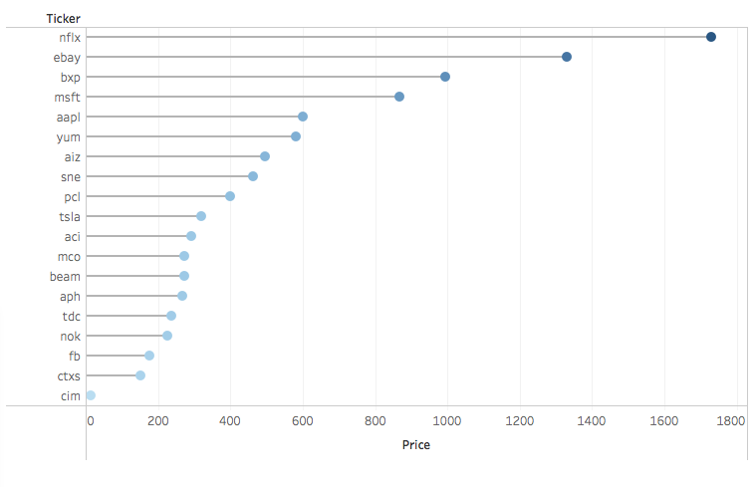
Analyzing the Training Data
The outlier Google was removed from the dataset. Random stocks were selected to show in a lollipop format the price of each.
Notes:
Jules

Slide 20
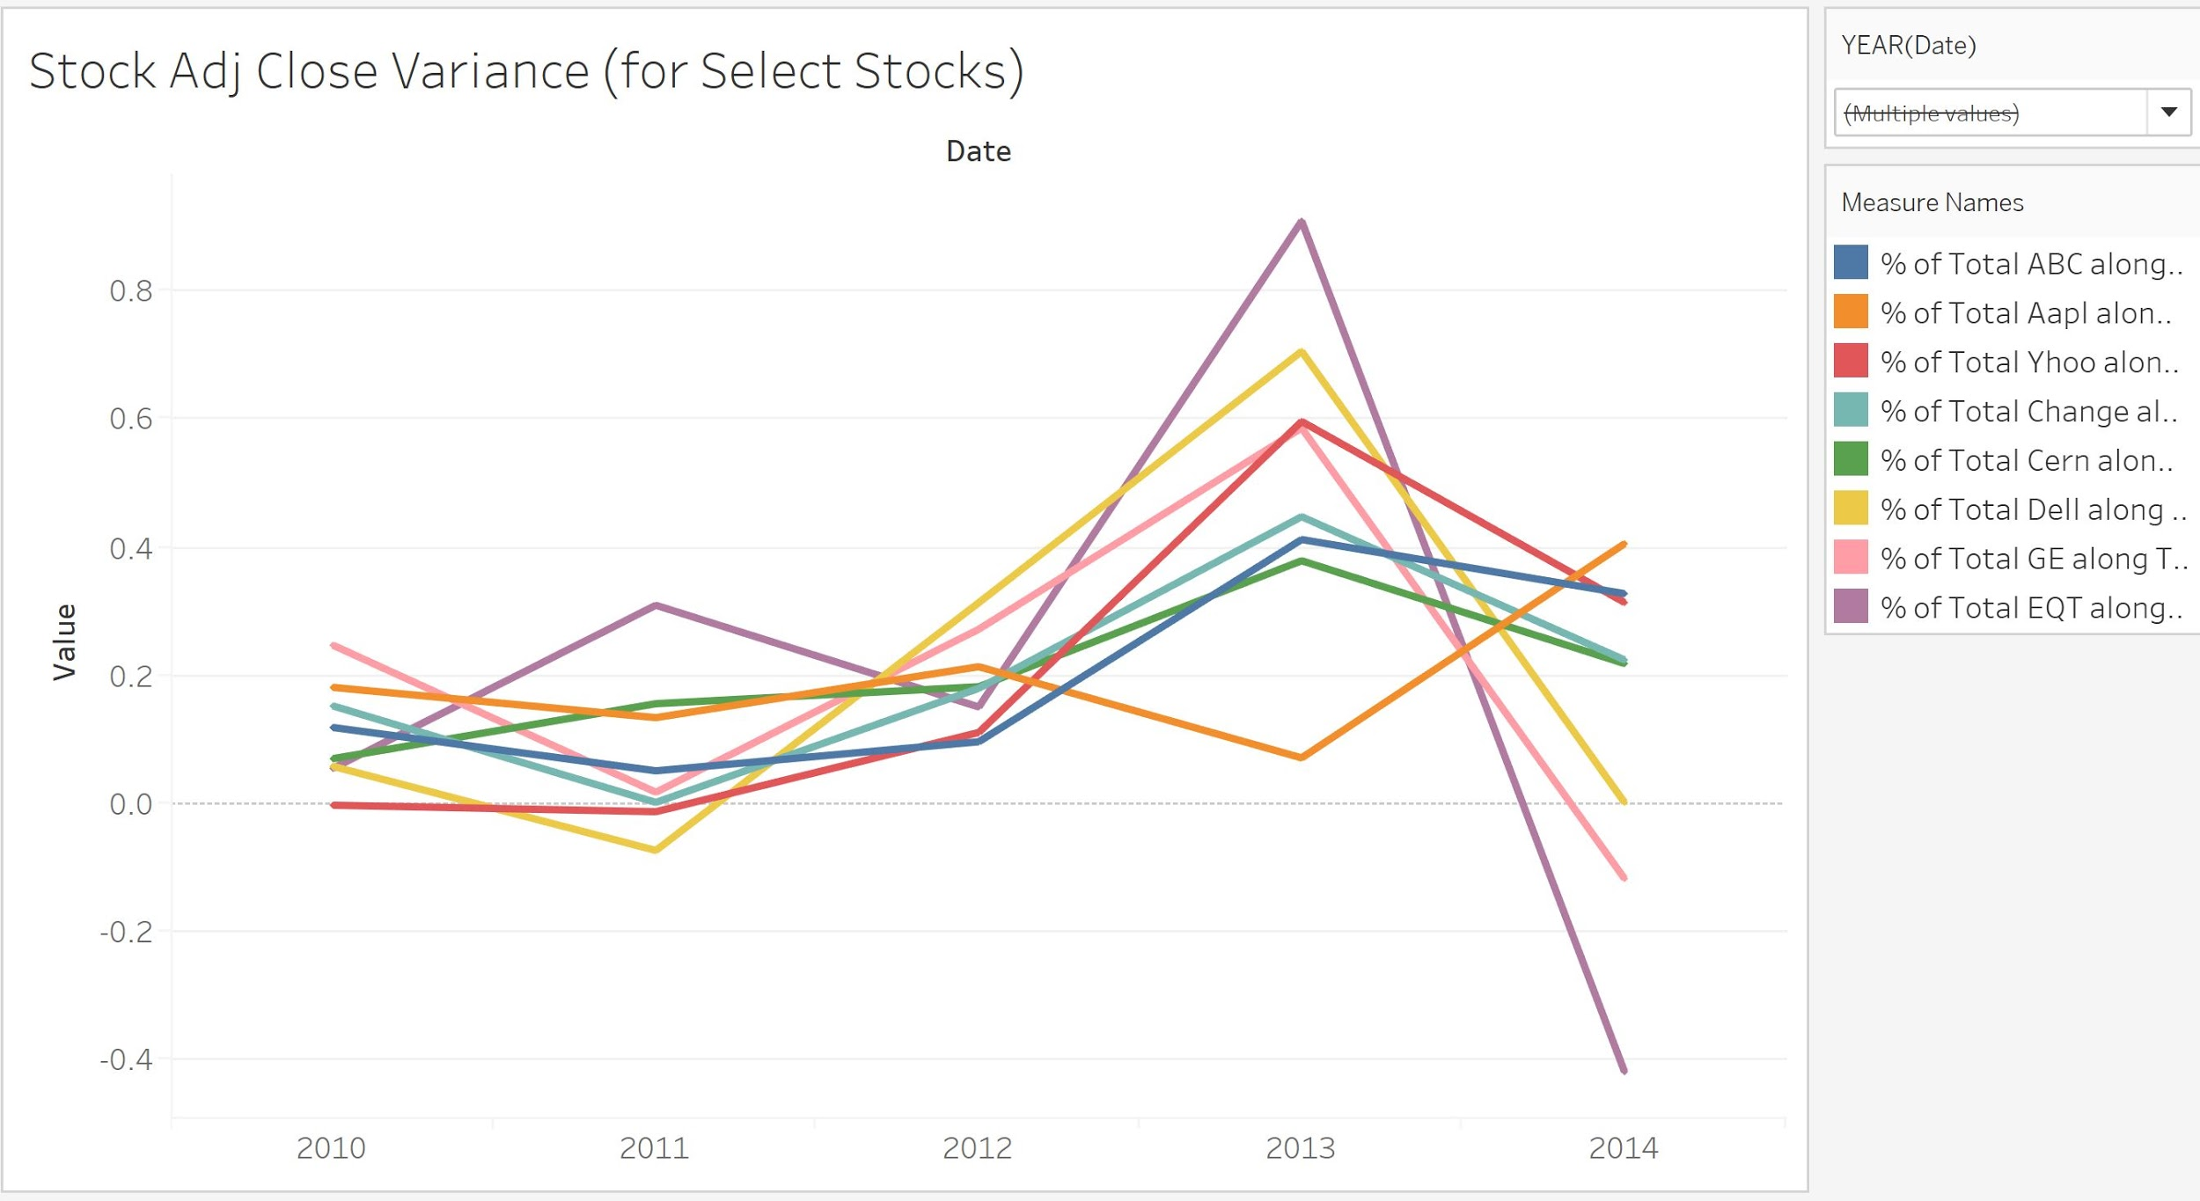
Analyzing the Training Data
Select stock variance over time
Notes:
Carre

Slide 21
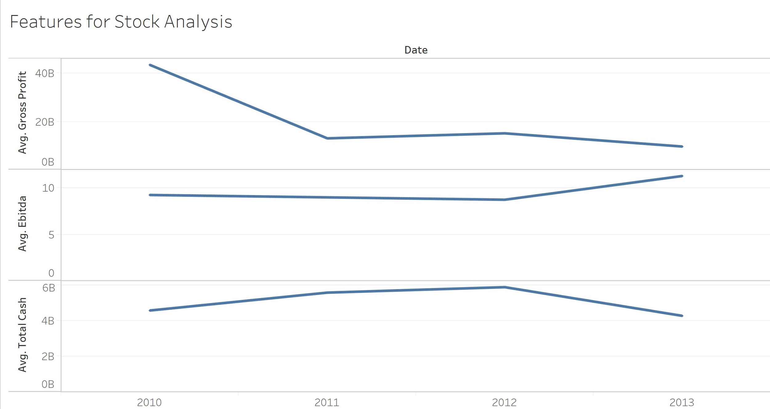
Narrowing down the features
We decided that the Gross Profit, EBITDA, and Total Cash would be the features we would focus on after initial machine learning model fitting.
Notes:
Carre

Slide 22
In Conclusion and Next Steps
Our model needs further training before it can be trusted to provide accurate predictions. We attempted various kernels (eg rbf) and other models (classification tree and random forest).
We also need to balance features against the various models. We decided EBTIDA, Cash on Hand, and Gross Profit were the key indicators to outperform the stock market but other features might be better indicators in other models.
We also want to classify and analyze based on sector (Tech, Labor, Retail etc).
Under and Over Performance should be graded as a scale instead of classification.
Notes:
Carre
Goal is to create a fairly accurate model in a vacuum that might be able to withstand othe outside influences such as inflation, conumer sentiment, etc.

Slide 23
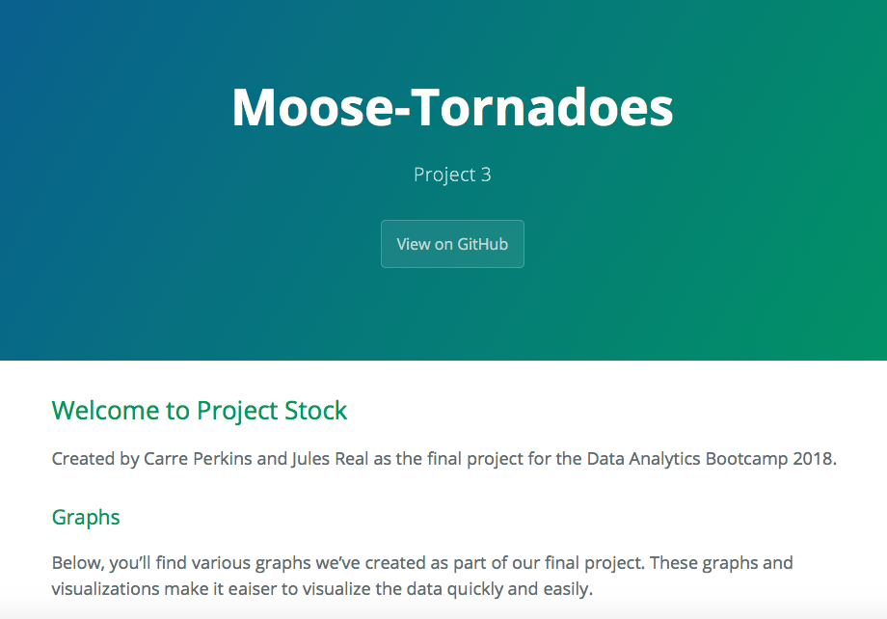
A Look At The Final Product
A look at the homepage of the project.
https://cjmoose3.herokuapp.com
Notes:
Jules

Slide 24
Thanks for watching!

